Slide 1
Operator Overloading (CS 1004)
Department of Computer Science,
National University of Computer & Emerging Sciences, Islamabad Campus

Slide 2
contents
Fundamentals of Operator Overloading, Overloading Binary Operators, Overloading the Binary Stream, Insertion and Stream Extraction Operators, Overloading Unary Operators, Overloading the Unary Prefix and Postfix ++ and -- Operators, Operators as Member Functions vs. Non-Member Functions, Converting between Types, explicit Constructors
7 Lectures (1 Hour /lec)

Slide 3
Operator Overloading – Part 1

Slide 4
Operator Overloading
The method of defining additional meanings for operators is known as operator overloading
Enables an operator to perform different operations depending upon the type of operands
The basic operators i.e. +, -, *, / normally works with basic types i.e. double, float, int, long. (defined in C++)
So, how can these operators can be applied to user-defined data types?

Slide 5
Operator Overloading Motivation
Don’t want to create new operators for user-defined data types
Conclusively, Operator overloading:
Enabling C++’s operators to work with class objects
Using traditional operators with user-defined objects
Requires great care; when overloading is misused, program difficult to understand
Examples of already overloaded operators:
Operator << is both the stream-insertion operator and the bitwise left-shift operator

Slide 6
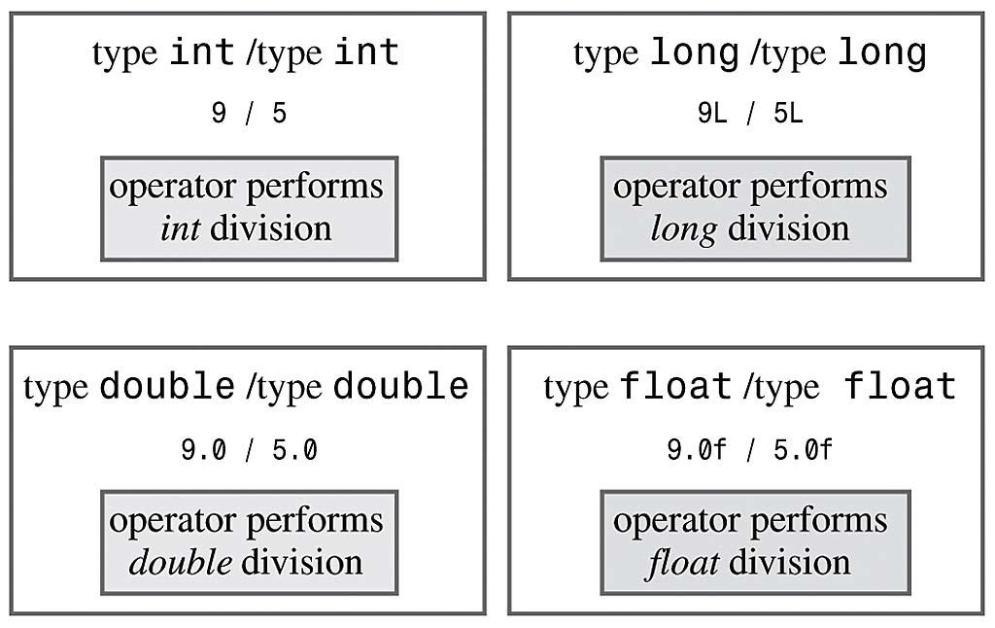
Operator Overloading
Example (already overloaded operator):

Slide 7
How to Overload an Operator?
An operator can be overloaded by declaring a special member function in the class
Name of the member function is operator that is followed by operator symbol e.g., operator+, operator/, etc.
Can be independent function (except for the following operators: ( ), [ ], -> or any of the assignment operators)
Can be a class’s member function (must be non-static)
Notes:
Can be a member function (must be non-static): to be able to work on objects of the class
If you plan on implementing ->, () or [] they are naturally member methods.
The binary operators = (assignment), [] (array subscription), -> (member access), as well as the n-ary () (function call) operator, must always be implemented as member functions, because the syntax of the language requires them to.

Slide 8
How to Overload an Operator?
Member function: If the left operand of that particular class is an object of the same class, then the overloaded operator is said to be implemented by a member function.
Non-member function: If the left operand of that particular class is an object of a different class, then the overloaded operator is said to be implemented by a non-member function
Notes:
Can be a member function (must be non-static): to be able to work on objects of the class
If you plan on implementing ->, () or [] they are naturally member methods.
A unary operator @, applied to an object x, is invoked either as operator@(x) [non member implementation] or as x.operator@() [member implementation]. A binary infix operator @, applied to the objects x and y, is called either as operator@(x,y) [non-member implementation] or as x.operator@(y) [member implementation]

Slide 9
Overload as Member or Non-Member Function
If it is a unary operator, implement it as a member function.
If a binary operator treats both operands equally (it leaves them unchanged), implement this operator as a non-member function.
If a binary operator does not treat both of its operands equally (usually it will change its left operand), it might be useful to make it a member function of its left operand’s type
Notes:
Can be a member function (must be non-static): to be able to work on objects of the class
If you plan on implementing ->, () or [] they are naturally member methods.
A unary operator @, applied to an object x, is invoked either as operator@(x) [non member implementation] or as x.operator@() [member implementation]. A binary infix operator @, applied to the objects x and y, is called either as operator@(x,y) [non-member implementation] or as x.operator@(y) [member implementation]

Slide 10
the << operator (when used for stream output, not bit shifting) gets an ostream as its first parameter, so it can't be a member of your class.

Slide 11
Syntax to Overload an Operator
returnType operator opsymbol(parameters){ }
↑ ↑ ↑ ↑ any type keyword operator symbol function body
return-type may be whatever the operator returns
Operator symbol may be any overloadable operator
Example:
void operator+ (parameters){ }
↑ ↑ ↑ ↑ any type keyword operator symbol function body

Slide 12
Operator Overloading
Operators are really functions
They have arguments, they return values
The only difference is that their names take on a specific form:
Operator+, operator[ ]
Overloading provides concise notation:
// without operator overloading object2 = object1.add(object2);
// with operator overloading
object2 = object2 + object1;

Slide 13
Restriction on Operator Overloading
With operator overloading we cannot change:
How operators act on built-in data types:
i.e., cannot change integer addition
Precedence of operator (order of evaluation)
Use parentheses to force order-of-operations
Association rules (left-to-right or right-to-left evaluation)
Number of operands
i.e., & is unary, only acts on one operand
Cannot create new operators
Operators must be overloaded explicitly:
i.e., Overloading + , does not overload +=
Notes:
at least one of the operands has to be of a user-defined type.

Slide 14
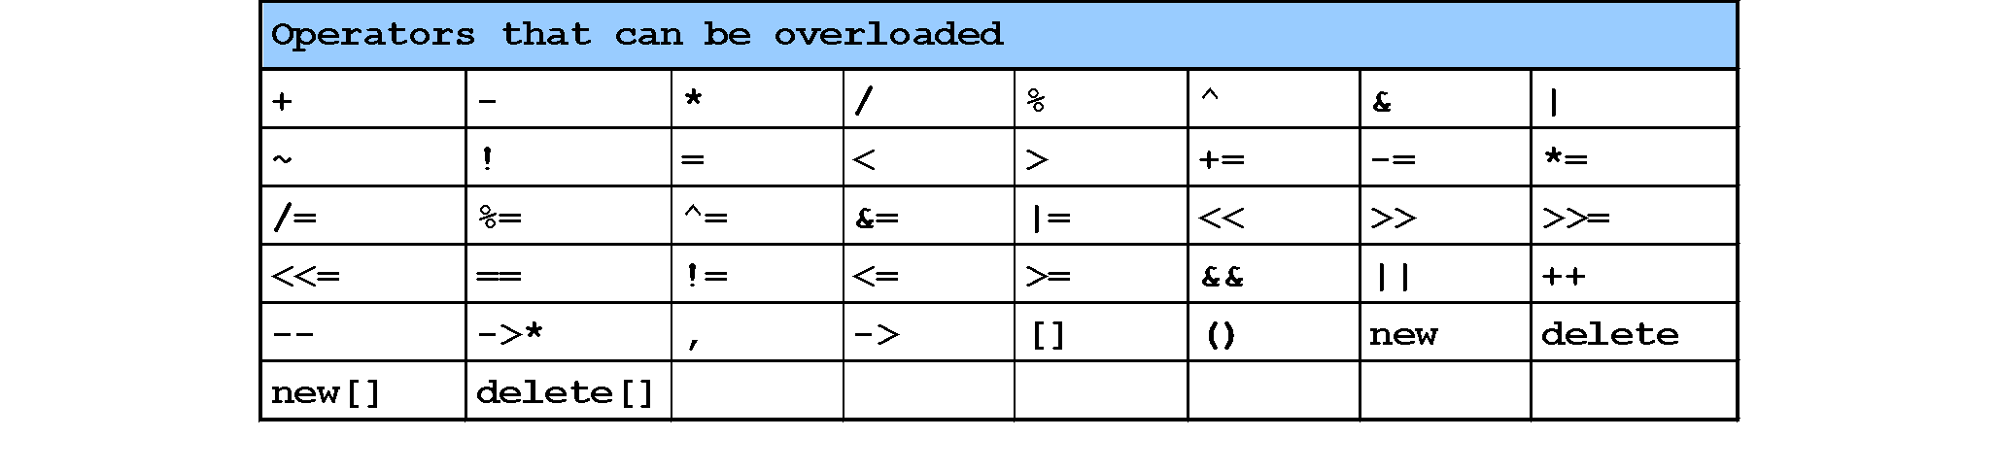
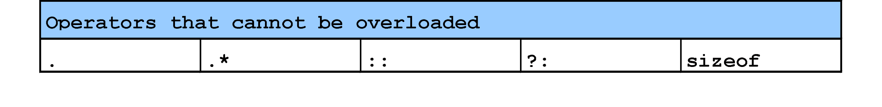
Restriction on Operator Overloading
http://www.stroustrup.com/bs_faq2.html#overload-dot
Notes:
The comma operator (represented by the token, ) is a binary operator that evaluates its first operand and discards the result, it then evaluates the second operand and returns this value (and type). The comma operator has the lowest precedence of any C operator, and acts as a sequence point.
->* is an operator to operate on function pointers
https://isocpp.org/wiki/faq/operator-overloading#overload-dot
http://www.stroustrup.com/bs_faq2.html#overload-dot
There is no fundamental reason to disallow overloading of ?:. I just didn't see the need to introduce the special case of overloading a ternary operator. Note that a function overloading expr1?expr2:expr3 would not be able to guarantee that only one of expr2 and expr3 was executed.
Sizeof cannot be overloaded because built-in operations, such as incrementing a pointer into an array implicitly depends on it. Consider:
Operator . (dot) could in principle be overloaded using the same technique as used for ->. However, doing so can lead to questions about whether an operation is meant for the object overloading . or an object referred to by . For example:

Slide 15
Operator =, operator &
Operator = and operator & are overloaded implicitly for every class, so they can be used for each class objects.
operator = performs member-wise copy of the data members.
operator & returns the address of the object in memory.

Slide 16
Function Overloading
An overloaded function is one which has the same name but several different forms.
For example: we can overload the constructor for the Date class:
default Date d;
initializing Date d(9,22,20);
copy Date d1(d);
other Date d(“Sept”,22,2020);

Slide 17
Operator Overloading
The operator “+” also has different semantics depending on the type of its “arguments”
Example
int i, j;
double d, e;
i + j; //add two int
i + d; //add an int and a double

Slide 18
Operator Overloading Syntax
a = b + c;
datatype operator + (datatype) { … }
Second parameter (can be native data type or user defined data type)
Remember operator+ is a function, and it will be called with the help of any object, thus the first parameter is the calling object
return parameter
(can be native data type or user defined data type)

Slide 19
Operator Overloading Syntax
datatype operator+ (datatype) { }
Example (1):
class myClass
{
int operator+ ( int );
}
int main ( )
{
int a, b;
myClass object;
a = object + b;
}

Slide 20
Operator Overloading Syntax
datatype operator+ (datatype)
Example (2):
class myClass
{
int operator+ ( myClass &a );
}
int main ( )
{
int a;
myClass object1, object2;
a = object1 + object2;
}

Slide 21
Operator Overloading Syntax
datatype operator+ (datatype)
Example (3):
class myClass
{ myClass operator+ ( int ); }
int main ( )
{
int a = 5;
myClass object1, object2;
object2 = object1 + a;
}

Slide 22
Operator Overloading Syntax
datatype operator+ (datatype)
Example (4):
class myClass
{
myClass operator+ ( myClass &a );
}
int main ( )
{
myClass object1, object2, object3;
object3 = object1 + object2;
}

Slide 23
Implementing Overloaded Operators
The compiler uses the types of arguments to choose the appropriate overloading.
int v1, v2;
v1 + v2; // int +
float s1, s2;
s1 + s2; // float+

Slide 24
Extended Example
Employee class and objects
class Employee
{
private:
int idNum;
double salary;
public:
Employee(int id, double salary);
double addTwo (Employee& emp);
double operator+ (Employee& emp);
double getSalary() { return salary; }
};

Slide 25
The member functions ‘addTwo’ and operator+
//function notation
double Employee::addTwo(Employee& emp)
{
double total;
total = this->salary + emp.getSalary();
return total;
}
//operator overloading notation
double Employee::operator+(Employee& emp)
{
double total;
total = this->salary + emp.getSalary();
return total;
}

Slide 26
Using the Member Functions
double sum;
Employee Clerk (111, 10000), Driver (222, 6000);
// these three statements do the same thing
sum = Clerk.addTwo(Driver);
sum = Clerk.operator+(Driver);
sum = Clerk + Driver;
// the syntax for the last one is the most natural
// and is easy to remember because it is consistent
// with how the + operator works for everything else

Slide 27
Multiple Operators
Often, you may need to reference an operator more than once in a expression:
Example:
total = a + b + c;
But this can cause big problems when operator overloading is involved
See next example…

Slide 28
Client Code for Class Employee
void main()
{
Employee Clerk(115, 20000.00);
Employee Driver(256, 15500.55);
Employee Secretary(567, 34200.00);
double sum;
sum = Clerk + Driver + Secretary;
cout << “Sum is “ << sum;
}

Slide 29
The Problem
Operator + is left to right associative, so Clerk and Driver are added. The result is a double.
Now that double is on the left and an Employee is on the right (i.e., Secretary)
BUT THE OPERATOR + is only defined for arguments of type Employee, not for double
Notes:
To do:
?? = int + object
but this one allows the int to come first in the call friend Fraction operator+(int n, Fraction f);
Note that these last two are not really needed in the Fraction class, since we have a conversion constructor! The normal operator+ function: friend Fraction operator+(const Fraction& f1, const Fraction& f2);

Slide 30
The Problem Gets Worse
It would seem that all we have to do is write another version of the overloaded operator to work with the argument (double)
But…
although we could overload an operator to work like this:
sum = Secretary + num;
We cannot overload (with member function) one like this:
sum = num + Secretary; // why not?
Notes:
Because:
sum = Secretary + num; 🡪 Employee class is called (with object Secretary) and double is passed as argument
sum = num + Secretary; 🡪 num is double (we cannot call + overloaded operator with a double value) and pass class Employee object [This is how we defined class]

Slide 31
The Answer
We cannot overload + for a double (a native type)
The real solution is to make sure that your operator+ function never returns a double (or any other native type).
An operator to add Employees should return an Employee (see next slide)

Slide 32
Extended Example
Employee class and objects
class Employee
{
private:
int idNum;
double salary;
public:
Employee(int id, double salary);
Employee operator+ (Employee& emp);
double getSalary() { return salary; }
}

Slide 33
Solution Example
Employee Employee::operator+(Employee& emp)
{
Employee total(999,0); // dummy values
total.salary = salary + emp.salary;
return(total);
}

Slide 34
Client Code for Class Employee
void main()
{
Employee Clerk(115, 20000.00);
Employee Driver(256, 15500.55);
Employee Secretary(567, 34200.00);
Employee sum(0, 0.0);
sum = Clerk + Driver + Secretary;
}

Slide 35
Invoking Objects
If the operator is binary but there is only one explicit argument, the ‘invoking instance’ is assumed to be the one on the left hand side of the expression.
class Date
{
public: // member functions
Date operator=(Date& d);
};
int main (void)
{
s1 = s2; // instead of s1.operator=(s2);
}

Slide 36
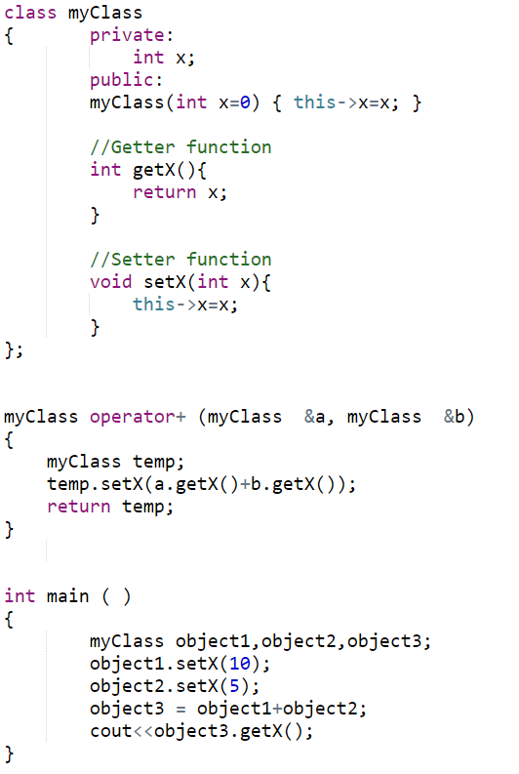
Non-member Operator Overloading Function

Slide 37
The Answer (double+object)
We cannot overload + for a double (a native type)
The real solution is to make sure that your operator+ function never returns a double (or any other native type).
An operator to add Employees should return an Employee (see next slide)
Solution 2: make a non-member operator overloading function.

Slide 38
Assignment Operator =
Operator = is overloaded implicitly for every class, so they can be used for each class objects.
operator = performs member-wise copy of the data members.
However, there is a problem with implicitly overloaded operator…(see next slide)
Notes:
Yes, if class contains pointers (dynamic allocations) to ensure a Deep Copy

Slide 39
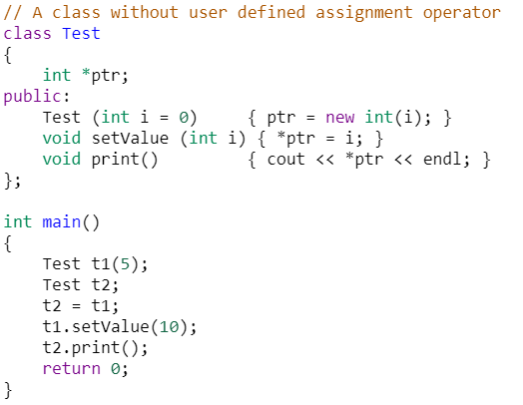
Using implicit Overloaded Assignment Operator
Notes:
Output = 10
https://www.geeksforgeeks.org/assignment-operator-overloading-in-c/

Slide 40
Operator Overloading – Part 2

Slide 41
Operator Overloading – Review
The variables of native data types can perform a number of different operations (functions) using operators ( +, - , / , *, etc)
Example: a + b * c
Example: if ( a < b )
However, with user defined (classes) objects we can not use operators:
Example: class obj1, obj2;
if ( ob1 < obj2 )

Slide 42
Operator Overloading – Review
To add operator functionality in the class
First create a function for the class
Set the name of the function with the operator name
operator + for the addition operator ‘+’
operator > for the comparison operator ‘>’

Slide 43
Extended Example
Employee class and objects
class Employee
{
private:
int idNum;
double salary;
public:
Employee(int id, double salary);
Employee operator+ (Employee& emp);
double getSalary() { return salary; }
};

Slide 44
Solution Example
Employee Employee::operator+(Employee& emp)
{
Employee total(999,0); // dummy values
total.salary = salary + emp.salary;
return(total);
}

Slide 45
Client Code for Class Employee
void main()
{
Employee Clerk(115, 20000.00);
Employee Driver(256, 15500.55);
Employee Secretary(567, 34200.00);
Employee sum(0, 0.0);
sum = Clerk + Driver + Secretary;
}

Slide 46
Overloading > operator
bool Employee::operator>(Employee& e)
{
return(seniority > e.seniority);
}
called from the program like this:
if (emp1 > emp2)

Slide 47
Operator Overloading Syntax
Although, the syntax of defining prototype:
datatype operator+ (datatype)
However, for some operators, there is little bit change in the above syntax:
++, -- operators
>>, << operators
& and [ ] operators

Slide 48
Overloading ++ and --
Operator ++ and -- are different to other operators of C++
We can call them:
either in the form of prefix (++i) before an object
or in the form of postfix (i++) after an object
But in both cases, the calling object will be i.

Slide 49
i++ and ++i ?
Prefix makes the change, and then it processes the variable
Postfix processes the variable, then it makes the change.
i = 1;
j = ++i;
(i is 2, j is 2)
i = 1;
j = i++;
(i is 2, j is 1)

Slide 50
Overloaded ++
class Inventory
{
private:
int stockNum;
int numSold;
public:
Inventory(int stknum, int sold);
void operator++();
};
void Inventory::operator++()
{
numSold++;
}

Slide 51
Use of the operator ++
int main ( )
{
Inventory someItem(789, 84);
// the stockNum is 789
// the numSold is 84
++someItem;
Inventory Item2 = ++someItem;
//will this instruction work
}
Notes:
Inventory Item 2 = ++someItem; // Will not work as the overloaded function does not return anything

Slide 52
Overloaded ++
class Inventory
{
private:
int stockNum;
int numSold;
public:
Inventory(int stknum, int sold);
Inventory& operator++();
};
Inventory& Inventory::operator++()
{
Inventory *object = new Inventory(0,0);
numSold++;
object->numSold = numSold;
return(*object);
}

Slide 53
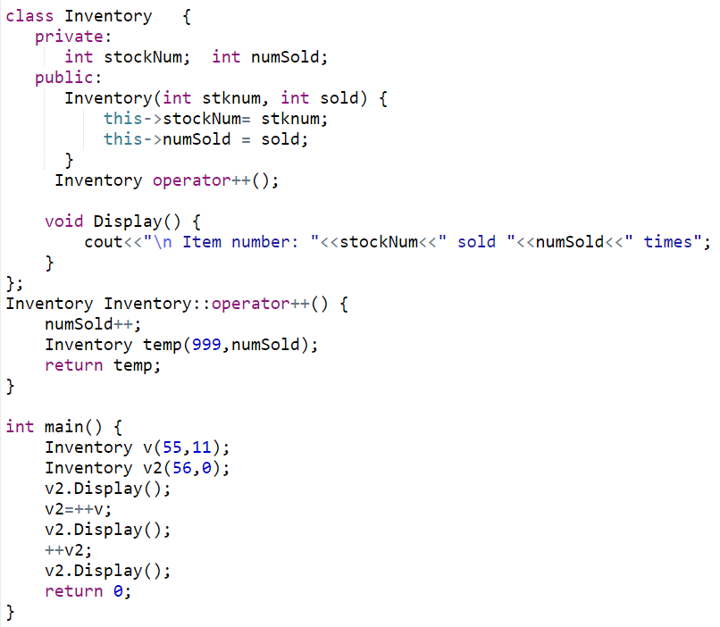
Using ++ (Prefix Notation)
Notes:
Item number: 56 sold 0 times
Item number: 999 sold 12 times
Item number: 999 sold 13 times

Slide 54
Problem
The definition of the prefix operator is easy enough. It increments the value before any other operation.
But, How will C++ be able to tell the difference between a prefix ++ operator and a postfix ++ operator?
Answer: overloaded postfix operators take a dummy argument (just for differentiation between postfix and prefix).

Slide 55
Postfix operator
Inventory& Inventory::operator++() // prefix version
{
Inventory *object = new Inventory(0,0);
numSold++;
object->numSold = numSold;
return(*object);
}
Inventory& Inventory::operator++(int) // postfix version
{
Inventory *object = new Inventory(0,0);
object->numSold = numSold;
numSold++;
return(*object);
}
dummy argument

Slide 56
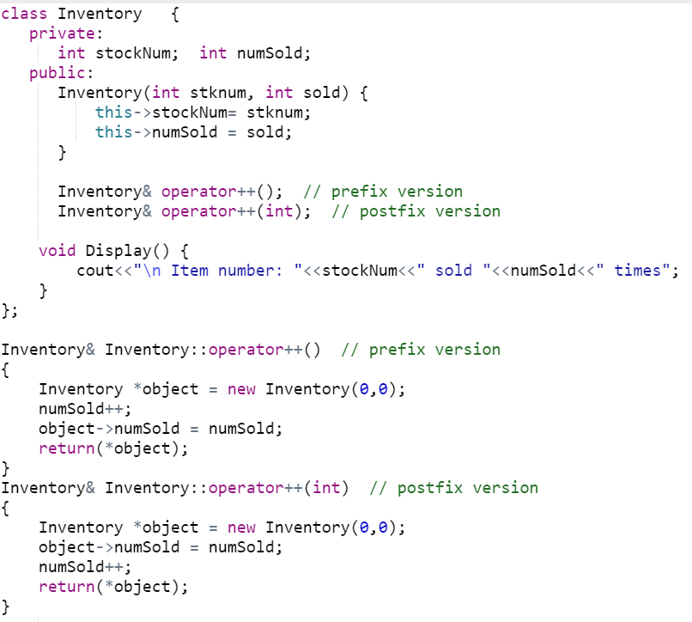
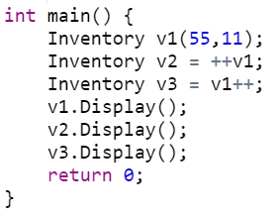
Postfix and Prefix ++
Notes:
Item number: 1 sold 13 times
Item number: 2 sold 12 times
Item number: 3 sold 12 times

Slide 57
Assignment Operator (=)
class Employee
{ private:
int idNum;
double salary;
public:
Employee ( ) { idNum = 0, salary = 0.0; }
void setValues (int a, int b);
void operator= (double );
}
void Employee::setValues ( int idN , double sal )
{
salary = sal; idNum = idN;
}
void Employee::operator = (double sal)
{ salary = sal; }

Slide 58
Assignment Operator (=)
int main ( )
{
Employee emp1;
emp1.setValues(10,33.5);
Employee emp2;
emp2 = 44.6; // emp2 is calling object
}

Slide 59
Assignment Operator (=)
class Employee
{ private:
int idNum;
double salary;
public:
Employee ( ) { idNum = 0, salary = 0.0; }
void setValues (int a, int b);
void operator= (Employee &emp );
}
void Employee::setValues ( int idN , double sal )
{ salary = sal; idNum = idN; }
void Employee::operator = (Employee &emp)
{ salary = emp.salary; }

Slide 60
Assignment Operator (=)
int main ( )
{
Employee emp1;
emp1.setValues(10,33.5);
Employee emp2;
emp2 = emp1; // emp2 is calling object
}

Slide 61
Comparison Operator (==)
class Employee
{ private:
int idNum;
double salary;
public:
Employee ( ) { idNum = 0, salary = 0.0; }
void setValues (int a, int b);
bool operator== (Employee &emp );
}
void Employee::setValues ( int idN , double sal )
{ salary = sal; idNum = idN; }
bool Employee::operator == (Employee &emp)
{ return (salary == emp.salary); }

Slide 62
Comparison Operator (==)
int main ( )
{
Employee emp1;
emp1.setValues(10,33.5);
Employee emp2;
emp2.setValues(10,33.1);
if ( emp2 == emp1 )
cout <<“Both objects have equal value”;
else
cout <<“objects do not have equal value”;
}

Slide 63
Subscript operator [ ]
With the help of [ ] operator, we can define array style syntax for accessing or assigning individual elements of classes
Student semesterGPA;
semesterGPA[0] = 3.5;
semesterGPA[1] = 3.3;

Slide 64
Subscript operator[ ]
class Student
{ private:
double gpa[8];
public:
Student ()
{ gpa[0]=3.5; gpa[1]=3.2; gpa[2]=4; gpa[3]=3.3;
gpa[4]=3.8; gpa[5]=3.6; gpa[6]=3.5; gpa[7]=3.8;
}
double& opeator[] (int Index);
}
double& Student::operator [ ] (int Index)
{
return gpa[Index];
}

Slide 65
Subscript operator[ ]
int main ( )
{
Student semesterGPA;
semesterGPA[0] = 3.7;
double gpa = semesterGPA[4];
}

Slide 66
Subscript operator[ ]
How the statement executes?
semesterGPA[0]=3.7;
The [ ] has highest priority than the assignment operator, therefore semesterGPA[0] is processed first.
semesterGPA[0] calls operator [ ], which then return a reference of semesterGPA.gpa[0].

Slide 67
Subscript operator[ ]
The return value is reference to semesterGPA.gpa[0], and the statement semesterGPA[0] = 3.7 is actually integer assignment.
int main ( )
{
Student semesterGPA;
semesterGPA[0] = 3.7;
// the above statement is processed like as
semesterGPA.gpa[0] = 3.7
}

Slide 68
Operator Overloading (CS 217) (Video Lecture – 25th March 2020)
Dr. Muhammad Aleem,
Department of Computer Science,
National University of Computer & Emerging Sciences, Islamabad Campus

Slide 69
Operator Overloading – Part 3

Slide 70
Calling an overloaded operator from native data types
In previous lectures, we were calling an overloaded operator of a class only with the help of its object (instance)
Point a, b, c;
// where + is overloaded in Point class
a = b + c;

Slide 71
Calling an overloaded operator from native data types
But, Can we call an overloaded operator of a class from the variables of native data types?
int variable;
Point object;
variable = variable + object;
In above example, it seems that we need to overload + operator for int (native-data type).
But in operator overloading we can't change the functionality of int data type

Slide 72
Calling an overloaded operator from native data types
Friend functions can help us in solving this problem.
Friend Function: A Friend function does not need an object of a class for its calling.
Thus, with a simple trick we can set parameter1 of an overloaded object to native data type and parameter2 to class object.

Slide 73
Friend Functions
Friend functions: can be given special grant to access private and protected members. A friend function can be: a) method of another class
b) global function
Friends should be used only for limited purpose, too many functions declared as friends with protected or private data access, lessens the value of encapsulation

Slide 74
Calling an overloaded operator from native data types
For friend function the syntax is changed, the first operator is moved from calling object to first parameter of function.
friend datatype operator+ (datatype, datatype)
First parameter (can be native data type or user defined data type)
Second parameter (can be native data type or user defined data type)
return parameter (can be native data type or user defined data type)

Slide 75
Example
class Point
{
private:
float m_dX, m_dY, m_dZ;
public:
Point(float dX, float dY, float dZ)
{
m_dX = dX;
m_dY = dY;
m_dZ = dZ;
}
friend float operator+ (float var1, Point &p);
};

Slide 76
Example
float operator+(float var1, Point &p)
{
return ( var1 + p.m_dX);
}
int main (void)
{
float variable = 5.6;
Point cPoint ( 2, 9.8, 3.3 );
float returnVar;
returnVar = variable + cPoint;
cout << returnVar; // 7.6
return 0;
}

Slide 77
Overloading iostream operators >> and <<
We can use friend function for overloading iostream operators ( >> or <<).
Usually iostream operators ( >> or << ) are not called from an object of the class
Point p;
cin >> p;
cout << p;
where cin and cout are object of iostream class
Notes:
cin and cout are object of iostream class
And hence these are calling objects

Slide 78
Overloading iostream operators >> and <<
We can define the prototype of iostream operators ( >> and << ) with the help of Friend function, and then we do not need any object of a class for their calling.

Slide 79
Example
class Point
{
private:
float m_dX, m_dY, m_dZ;
public:
Point(float dX, float dY, float dZ)
{
m_dX = dX;
m_dY = dY;
m_dZ = dZ;
}
friend ostream& operator<< (ostream &out, Point &cPoint);
friend istream& operator>> (istream &in, Point &cPoint);
};

Slide 80
Example
ostream& operator<< (ostream &out, Point &cPoint)
{
out << "(" << cPoint.m_dX << ", " <<
cPoint.m_dY << ", " << cPoint.m_dZ <<")";
return out;
}
istream& operator>> (istream &in, Point &cPoint)
{
in >> cPoint.m_dX;
in >> cPoint.m_dY;
in >> cPoint.m_dZ;
return in;
}

Slide 81
Example
int main (void)
{
cout << "Enter a point: " << endl;
Point cPoint;
cin >> cPoint;
cout << "You entered: " << cPoint << endl;
}

Slide 82
Overloading iostream operators >> and <<
But, what is the advantage of returning references of iostream objects
friend ostream& operator<< (ostream &out, Point &cPoint);
friend istream& operator>> (istream &in, Point &cPoint);
In order to understand above, let take a look on the first and second parameters in case of >> and <<
Point cPoint;
cin >> cPoint; // cin is first parameter and
// cPoint is second parameter
Is above statement (cin >> cPoint) returning anything?

Slide 83
Overloading iostream operators >> and <<
Is above statement (cin >> cPoint) returning anything?
It is returning reference of iostream object, thus in above statement the cin reference is returned that can be further used for
Point cPoint1, cPoint2;
cin >> cPoint1 >> cPoint2;
In above statement (cin >> cPoint1) returns a reference of cin which is further used for ( cin >> cPoint2)

Slide 87
Data Conversion
Conversion between basic types
Conversion between Objects and basic types
Conversion between Objects of different classes

Slide 88
Conversion b/w Basic Types
When we use two different Types:
intvar=floatvar; //the compiler calls a special routine // that converts this value from // floating point format to integer // format.
There are many such conversion routines build in C++ compiler and called upon when any such conversion is required.

Slide 89
Explicit Conversion
if we want to force compiler to convert data from one native type to other, we can use explicit casting, intvar=int(floatvar)
it is obvious in listing that int( ) conversion function will convert from float to int.
This explicit conversion uses same build in routines.

Slide 90
Conversion Between Objects and Basic Types
To convert from a basic type ( i.e., float) to object types (i.e., Distance), we use a constructor with one argument.
Distance(float meters){ }
This function is called when an object of type Distance is created with a single argument.
This conversion allows a floating value to be assigned to a Distance type object.

Slide 91
Distance dist1=2.35; // constructor
Above, one argument constructor will be called.
Same conversion can be achieved by providing overloaded ‘=‘ operator which takes a float value as argument.

Slide 92
From User Defined to Basic
What if want to go from user-defined types(Distance) to native type(float)?
The trick here is to overload the cast operator, creating something called a “Conversion function”.
operator float() {
return floating_rep;
}
NOTE: the conversion function does not need return type
Conversion functions have no arguments, and the return type is implicitly the conversion type

Slide 93
From User Defined to Basic
This operator takes the value of the distance object of which it is a member, converts this value to a float value and returns this value.
This operator can be called like this:
float floatmtrs = float(dist2);
float floatmtrs = dist2;
both statements have exactly same effects.

Slide 94
From User Defined to Basic
class Employee
{ private:
float salary;
public:
Employee ( float sal ) { salary = sal; }
operator float();
}
Employee::operator float( )
{
return salary;
}

Slide 95
From User Defined to Basic
int main ( )
{
Employee emp1(33.5);
float value = float(emp1);
cout << value; // 33.5
}

Slide 96
Conversion between Objects of Different Classes
Both methods shown before can be applied to conversion between objects of different basic types (i.e., one argument constructor, and conversion function).

Slide 97
Example
There are two classes, Polar and Rec.
We want to be able to convert an object of type Polar to an object of type Rec.
i.e., rec=pol;
provide one argument constructor in class Rec.

Slide 98
Rec(Polar p){
//procees p’s data and convert(assign)
//it into object Rec.
}
rec=pol;
/*one argument constructor will be called to perform the conversion*/

Slide 99
Pitfalls of Operator Overloading and Conversion
With the help of Operator overloading we can create entirely new language.
For example for a = b + c we can implement a new methodology on user-defined types.
But care should be taken as doing something different than native data types could make your code hard to read and understand

Slide 100
Use Similar Meanings
Implement the operation of overloaded operator similar to native data types.
For example, adding two strings makes sense as we take adding as “concatenation” of two strings
but adding two “Employees” having personal data in them doesn’t make much sense.

Slide 101
Show Restraint
Make sure that user of your class will easily know the purpose of overloading an operator.
Sometime it make more sense to use functions, as their names may suggest what they are to perform.
Use overloaded operator sparingly and only when the usage is obvious.

Slide 102
Case Study: A Date Class
The following example creates a Date class with
An overloaded increment operator to change the day, month and year
An overloaded += operator
A function to test for leap years
A function to determine if a day is last day of a month

Slide 103
1 // Fig. 8.6: date1.h
2 // Definition of class Date
3
4
5 #include <iostream>
6
7
8
9 class Date {
10 friend ostream &operator<<( ostream &, Date & );
11
12 public:
13 Date( int m = 1, int d = 1, int y = 1900 ); // constructor
14 void setDate( int, int, int ); // set the date
15 Date &operator++(); // preincrement operator
16 Date operator++( int ); // postincrement operator
17 Date &operator+=( int ); // add days, modify object
18 bool leapYear( int ); // is this a leap year?
19 bool endOfMonth( int ); // is this end of month?
20
21 private:
22 int month;
23 int day;
24 int year;
25
26 static int days[]; // array of days per month
27 void helpIncrement(); // utility function
28 };
29
30

Slide 104
31 // Fig. 8.6: date1.cpp
32 // Member function definitions for Date class
33 #include <iostream>
34 #include "date1.h"
35
36 // Initialize static member at file scope;
37 // one class-wide copy.
38 int Date::days[] = { 0, 31, 28, 31, 30, 31, 30,
39 31, 31, 30, 31, 30, 31 };
40
41 // Date constructor
42 Date::Date( int m, int d, int y ) { setDate( m, d, y ); }
43
44 // Set the date
45 void Date::setDate( int mm, int dd, int yy )
46 {
47 month = ( mm >= 1 && mm <= 12 ) ? mm : 1;
48 year = ( yy >= 1900 && yy <= 2100 ) ? yy : 1900;
49
50 // test for a leap year
51 if ( month == 2 && leapYear( year ) )
52 day = ( dd >= 1 && dd <= 29 ) ? dd : 1;
53 else
54 day = ( dd >= 1 && dd <= days[ month ] ) ? dd : 1;
55 }
56
57 // Preincrement operator overloaded as a member function.
58 Date &Date::operator++()
59 {
60 helpIncrement();
61 return *this; // reference return to create an lvalue
62 }
63

Slide 105
64 // Postincrement operator overloaded as a member function.
65 // Note that the dummy integer parameter does not have a
66 // parameter name.
67 Date Date::operator++( int )
postincrement operator has a dummy int value.
68 {
69 Date temp = *this;
70 helpIncrement();
71
72 // return non-incremented, saved, temporary object
73 return temp; // value return; not a reference return
74 }
75
76 // Add a specific number of days to a date
77 Date &Date::operator+=( int additionalDays )
78 {
79 for ( int i = 0; i < additionalDays; i++ )
80 helpIncrement();
81
82 return *this; // enables cascading
83 }
84
85 // If the year is a leap year, return true;
86 // otherwise, return false
87 bool Date::leapYear( int y )
88 {
89 if ( y % 400 == 0 || ( y % 100 != 0 && y % 4 == 0 ) )
90 return true; // a leap year
91 else
92 return false; // not a leap year
93 }
94
95 // Determine if the day is the end of the month
96 bool Date::endOfMonth( int d )
97 {

Slide 106
98 if ( month == 2 && leapYear( year ) )
99 return d == 29; // last day of Feb. in leap year
100 else
101 return d == days[ month ];
102 }
103
104 // Function to help increment the date
105 void Date::helpIncrement()
106 {
107 if ( endOfMonth( day ) && month == 12 ) { // end year
108 day = 1;
109 month = 1;
110 ++year;
111 }
112 else if ( endOfMonth( day ) ) { // end month
113 day = 1;
114 ++month;
115 }
116 else // not end of month or year; increment day
117 ++day;
118 }
119
120 // Overloaded output operator
121 ostream &operator<<( ostream &output, Date &d )
122 {
123 char *monthName[ 13 ] = { "", "January",
124 "February", "March", "April", "May", "June",
125 "July", "August", "September", "October",
126 "November", "December" };
127
128 output << monthName[ d.month ] << ' '
129 << d.day << ", " << d.year;
130
131 return output; // enables cascading
132 }

Slide 107
133 // Fig. 8.6: fig08_06.cpp
134 // Driver for class Date
135 #include <iostream>
136
137
138
139
140 #include "date1.h"
141
142 int main()
143 {
144 Date d1, d2( 12, 27, 1992 ), d3( 0, 99, 8045 );
145 cout << "d1 is " << d1
146 << "\nd2 is " << d2
147 << "\nd3 is " << d3 << "\n\n";
148
149 cout << "d2 += 7 is " << ( d2 += 7 ) << "\n\n";
150
151 d3.setDate( 2, 28, 1992 );
152 cout << " d3 is " << d3;
153 cout << "\n++d3 is " << ++d3 << "\n\n";
154
155 Date d4( 3, 18, 1969 );
156
157 cout << "Testing the preincrement operator:\n"
158 << " d4 is " << d4 << '\n';
159 cout << "++d4 is " << ++d4 << '\n';
160 cout << " d4 is " << d4 << "\n\n";
161
162 cout << "Testing the postincrement operator:\n"
163 << " d4 is " << d4 << '\n';
164 cout << "d4++ is " << d4++ << '\n';
165 cout << " d4 is " << d4 << endl;
166
167 return 0;
168 }

Slide 108
d1 is January 1, 1900
d2 is December 27, 1992
d3 is January 1, 1900
d2 += 7 is January 3, 1993
d3 is February 28, 1992
++d3 is February 29, 1992
Testing the preincrement operator:
d4 is March 18, 1969
++d4 is March 19, 1969
d4 is March 19, 1969
Testing the postincrement operator:
d4 is March 19, 1969
d4++ is March 19, 1969
d4 is March 20, 1969

Slide 109
String Library
We will use operator overloading to build String library
Overloaded Operators
= (for text assignment)
== (for comparison between two strings)
ostream and istream (for cin and cout)
+ (for adding two strings)
[ ] (for retrieving or changing single character in string)

Slide 110
String Library
class String
{
private:
char *text;
public:
String(char *str)
{
text = new char[strlen(str)];
strcpy(text,str);
}
friend ostream& operator<<(ostream &,String &str);
friend istream& operator>>(istream &,String &str);
void operator= (char *str);
};

Slide 111
String Library
String& operator+(String &str);
String& operator+(char *str);
bool operator==(String &str);
bool operator==(char *str);
char& operator[] (int Index);
};
bool String::operator == ( char *str )
{
bool val;
val = strcmp(text,str);
if ( val == 0 )
return true;
else
return false;
}

Slide 112
String Library
bool String::operator == ( String &par)
{
bool val;
val = strcmp(text,par.text);
if ( val == 0 )
return true;
else
return false;
}
void String::operator = (char *str)
{
text = new char[ strlen(str) ];
strcpy(text,str);
}

Slide 113
String Library
String& String::operator + (String &par)
{
String iSt = "";
int length = 0;
length = strlen(text);
length += strlen(par.text);
iSt.text = new char[length];
strcpy(iSt.text,text);
strcat(iSt.text,par.text);
return iSt;
}

Slide 114
String Library
String& String::operator + (char *str)
{
String iSt = "";
int length = 0;
length = strlen(text);
length += strlen(str);
iSt.text = new char[length];
strcpy(iSt.text,text);
strcat(iSt.text,str);
return iSt;
}

Slide 115
String Library
ostream& operator<< (ostream &out, String &str)
{
out << str.text;
return out;
}
istream& operator>> (istream &in, String &str)
{
char temp[200];
in >> temp;
text = new char[strlen(temp)];
strcpy(text,temp);
return in;
}

Slide 116
String Library
char& String::[] (int Index)
{
return text[Index];
}
//String string1 = “hello”;
// string1[0] = ‘a’;
//string1.text[0] = ‘a’;
// char c = string1[0];

Slide 117
String Library
int main ( )
{
String string1 = “hello”;
String string2 = “”;
string1 = “hello world”;
cout << “Enter string 2 text” << endl;
cin >> string2;
if ( string1 == string2 )
cout << “Both strings are equal” << endl;
string2[0] = ‘a’;
string2[1] = ‘b’;
cout << “The second string is “ << string2 << endl;
cout << the first character is “<< string1[0] << endl;
}

